Slide 1

Ali Bagheri M.D
Assistant Professor in Radiation Oncology
Director of Brachytherapy Services at Ahvaz Golestan Hospital
Radiation Oncology Department
Ahvaz Jundishapur University of Medical Sciences

Slide 2
QUANTEC & RTOG
Quantitative Analysis of Normal Tissue Effects in the Clinic Study
Radiation Therapy Oncology Group protocols
Radiation-induced late organ toxicities
Grading of late toxicities
Recommended normal tissue dose constraints for both conventional fractionation and hypofractionated treatment courses

Slide 3
Background
Modern treatment planning technologies allow for highly precise and customizable dose delivery to target volumes, resulting in highly nonuniform dose distributions to surrounding normal tissues.
When radiation combined with additional treatment modalities (chemotherapy or immunotherapy), radiation doses customarily deemed safe may no longer be so because such doses may produce increasingly severe late effects.

Slide 4
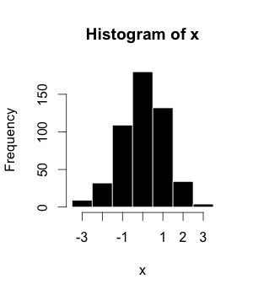
Histogram

Slide 5
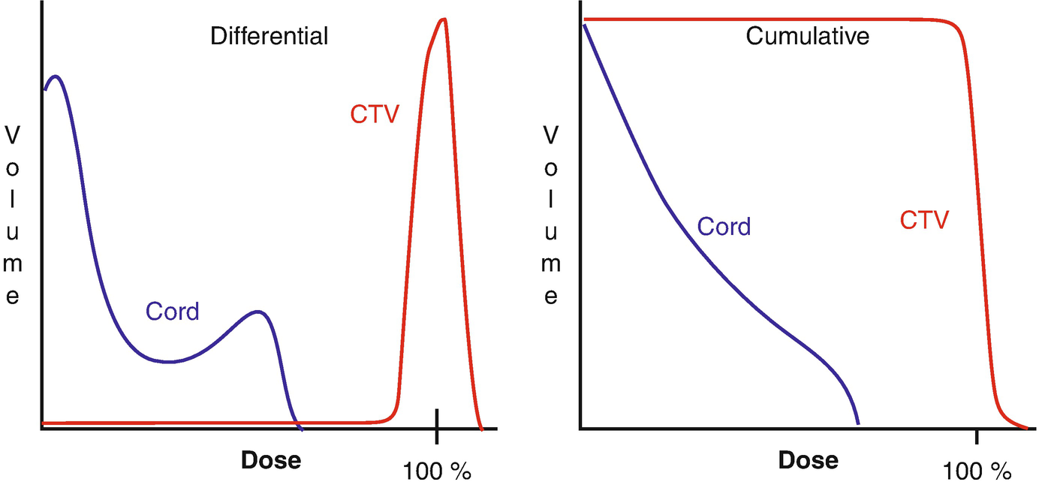
Dose-volume histograms (DVHs)

Slide 6
Dose-volume histograms (DVHs)
Maximum doses
Minimum doses
Mean doses
D percentage: allows the analysis of a dose (D) that encompasses a percentage of a volume of interest (eg, D100, D90, and D80 represent the dose encompassing 100%, 90%, and 80% of a volume of interest, respectively).
V percentage: allows the analysis of a percent volume (V) that receives a particular dose (eg, V100, V90, and V80 represent the percent of a volume of interest that receives 100%, 90%, and 80% of the prescribed dose, respectively).

Slide 7
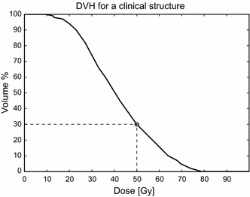
Example & Practice
Maximum dose = 80Gy
V50Gy=30%
D30%=50Gy
Practice:
  V40Gy=
  D60%=
50%
36Gy

Slide 8
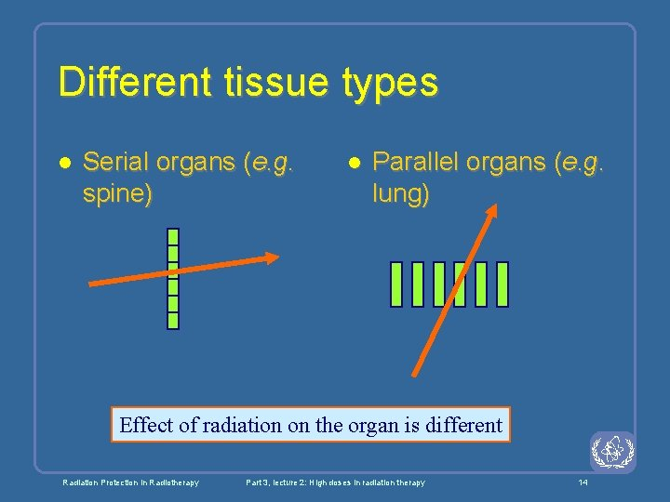

Slide 9
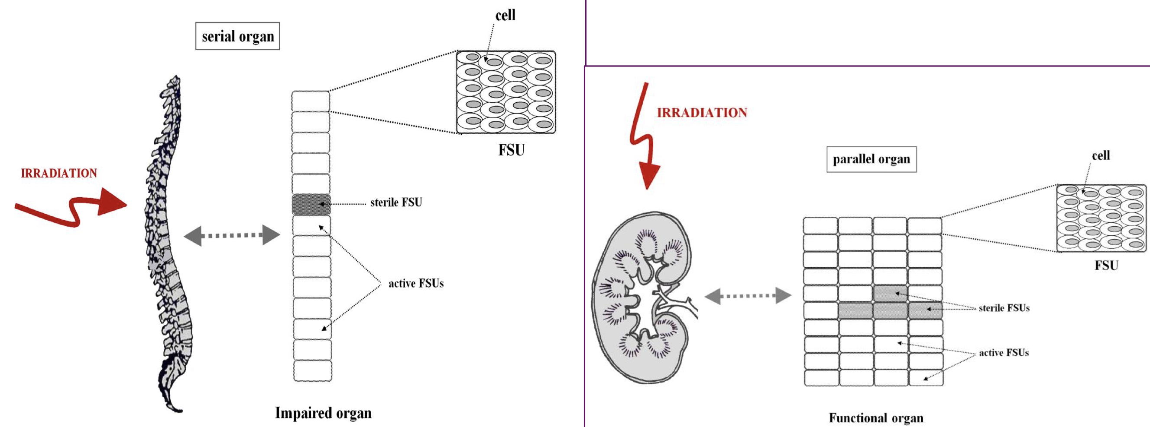

Slide 10
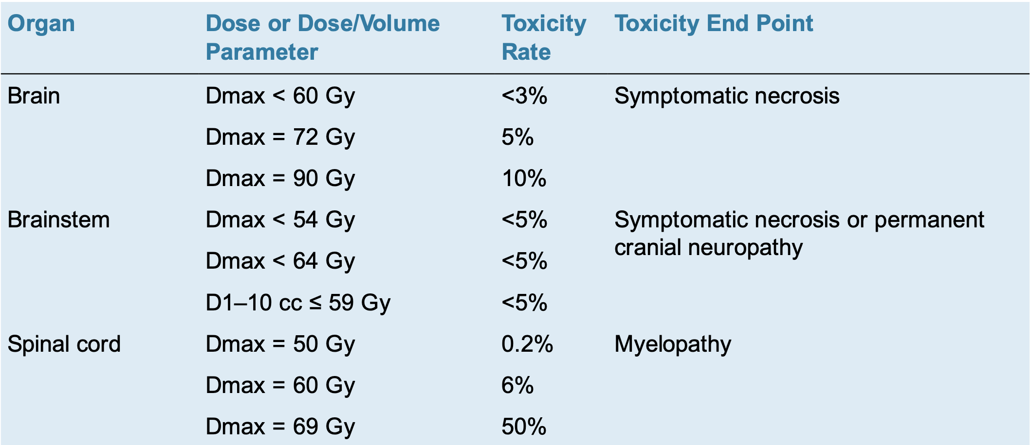
Serial Organs

Slide 11
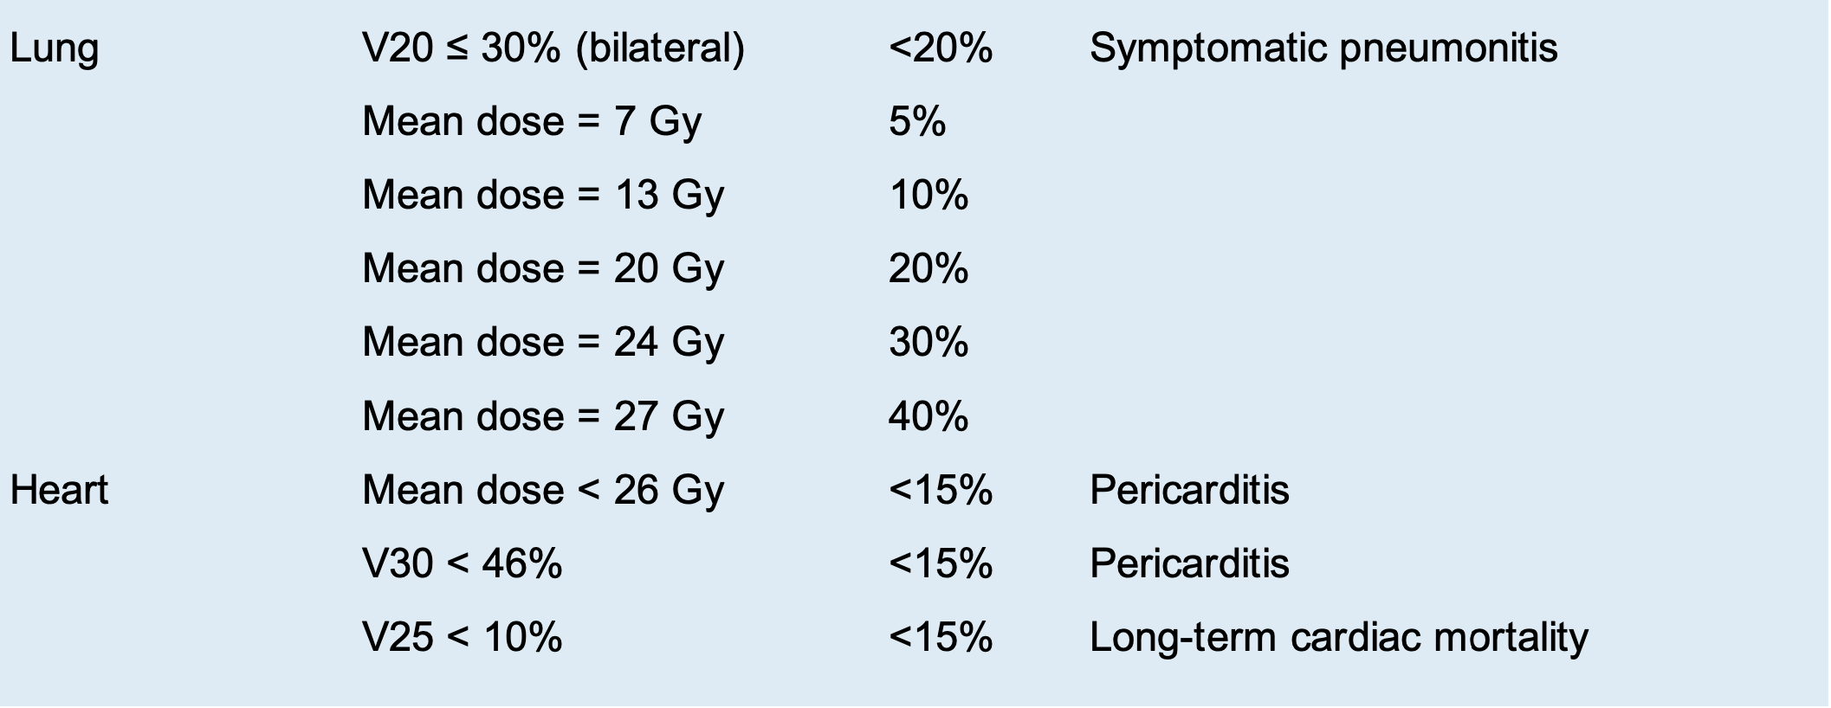
Parallel Organs

Slide 12
Clinical Presentation
Brain
  Headache, somnolence, intellectual deficits, functional neurologic losses, and memory alterations
Spinal cord
  May include paresthesias (including tingling, pain, and Lhermitte’s syndrome), numbness, weakness, or loss of sphincter control that can progress to total paraparesis and paraplegia.
Lung
  Radiation pneumonitis may present with cough, dyspnea, pleuritis, and pink-colored sputum.

Slide 13
Clinical Presentation
Heart
  Pericardial disease is the most common cardiac complication, although coronary artery disease (CAD), cardiomyopathies, conduction defects, and valvular disease can also occur as late complications.
Esophagus
  Acute esophagitis may present with chest discomfort, dysphagia, or odynophagia.
  Late complications may include esophageal strictures, ulcers, or rarely tracheoesophageal (TE) fistula.

Slide 14
Clinical Presentation
Liver
  Radiation-induced liver disease can present with weight gain, ascites, or hepatomegaly. Patients may present with vague-to-intense right upper quadrant pain.
Kidney
  Hypertension
Small and large intestines
  Acute radiation enteritis presents with abdominal pain, nausea, vomiting, or diarrhea. Radiation proctitis can also present with tenesmus, fecal urgency, or rectal bleeding.
  Late radiation-induced bowel toxicities may include abdominal pain, weight loss, malabsorption, bowel strictures, bowel obstruction, ulceration, or fistula formation.

Slide 15
Clinical Presentation
Salivary glands
  Xerostomia presents with a wide range of severity, from mild inconvenience in eating/speaking to debilitating dysfunction. Deterioration of oral health and alteration of eating function from reduced salivary flow can dramatically impact patient quality of life.
Cornea, lacrimal gland, and lens
  Mild radiation-induced keratitis presents with tearing, discomfort, or foreign body sensation. Lacrimal gland toxicity can lead to keratoconjunctivitis sicca, which in severe cases may lead to corneal ulceration. Irradiation of lenses commonly causes radiation-induced cataracts.

Slide 16
Clinical Presentation
Retina and optic tract
  Optic neuropathy and radiation retinopathy are often asymptomatic, but may present with visual distortion or painless visual impairment. Microaneurysms, telangiectasias, macular edema, and retinal hemorrhages may occur.

Slide 17
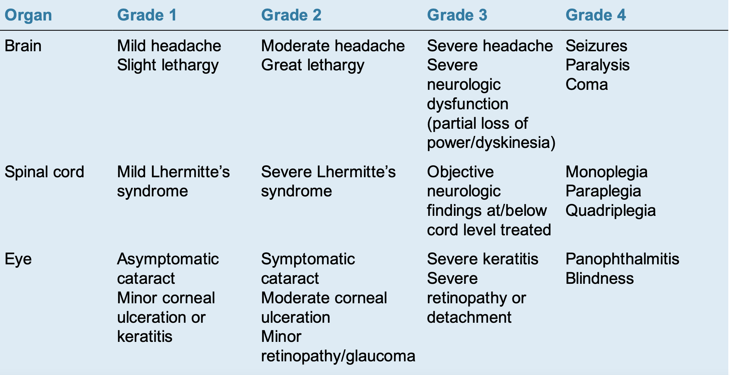

Slide 18
